Slide 1
Capstone Project
Credit Card Fraud Detection
Kamal Tamang

Slide 2
1. Objectives 2. Background 3. Key Insights 4. Cost Benefits Analysis 5. Appendix: a. Data Attributes b. Data Methodology c. Attached Files
Agenda

Slide 3
Objective
Getting in place a credit card fraud detection model to save on incurred costs
Huge costs are being incurred due to frauds and a manual detection system
Background
A machine learning model has been built to detect frauds early and mitigate losses
2. A cost benefit analysis has been done for the deployment of the same

Slide 4
Background
With the rise in digital payment channels and competitive market, the number of fraudulent transactions has increased drastically due to which credit card companies are facing a significant challenges. Retaining high profitable customers has became risk for reputed banking companies. This fraud has poses a significant threat to achieve goal in terms of substantial financial loss, trust, and credibility. Banking fraud is a concerning issue for both banks and as well as customers. With the rise in digital payment the number of fraudulent transactions is increasing as fraudsters are finding new and different ways to commit such crimes.
The Federal Trade Commission (US) has estimated that around 10 million people become victims of credit card theft each year. Credit card companies lose close to $50 billion per year to fraud.

Slide 5
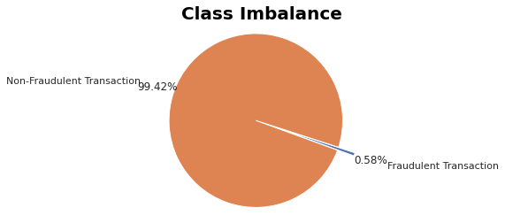
We can see there is an imbalance in the data. Fraud transactions only make up to 0.58% of the total transactions
Key Insight

Slide 6
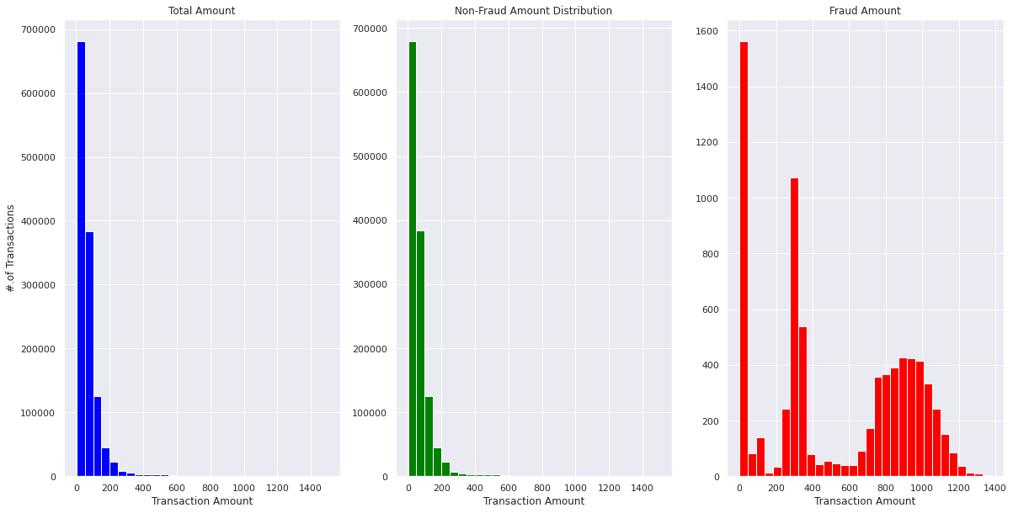
Transaction Amount Distribution
Here we can see that the concentration of fraudulent transactions is split into two major clumps. Under transactions of value $400 and again between $800 and $1,100

Slide 7
Cost Benefit Analysis
Average monthly undetected fraudulent transactions dropped by 77.5% post deployment

Slide 8
Cost Benefit Analysis
Average Monthly Cost incurred due to fraudulent transactions dropped by 83.17%.

Slide 9
Cost Benefit Analysis
Monthly cost incurred in USD ($)
After implementing model we can find massive saving

Slide 10
Appendix: Data Attributes
Snapshot of the data :
Reading and Understanding the Data
Exploratory Data Analysis
Model Building and Hyper parameter Tuning
Logistic Regression Un-sampled
Logistic Regression with SMOTE, ADASYN
Decision Tree Un-sampled
Decision Tree with SMOTE, ADASYN
Random Forest Un-sampled
Random Forest with SMOTE, ADASYN
XGBoost Un-sampled
XGBoost with SMOTE, ADASYN
Testing the results on the unseen Test Data
Model Selection and Model Building
Cost Benefit Analysis

Slide 11
Appendix : Data Methodology
Fraudulent transaction in class imbalance, univariate analysis is shown in EDA.
Logistic Regression, Decisions Tree, Random Forest & XGBoost using SMOTE and ADASYN sampling method explained.
Testing the results on the unseen Test Data.
Cost Benefit Analysis.

Slide 12
Attached Files
Cost Benefits Analysis
Structured Problem Solving
Credit Card Fraud Detection.ipynb

Slide 13
Thank You

